Slide 1
Discrete Mathematics
Spring 2020
Yuan Ze University

Slide 2
Some properties of trees

Slide 3
Observation

Slide 4
Illustration
…
u
v
…
…

Slide 5
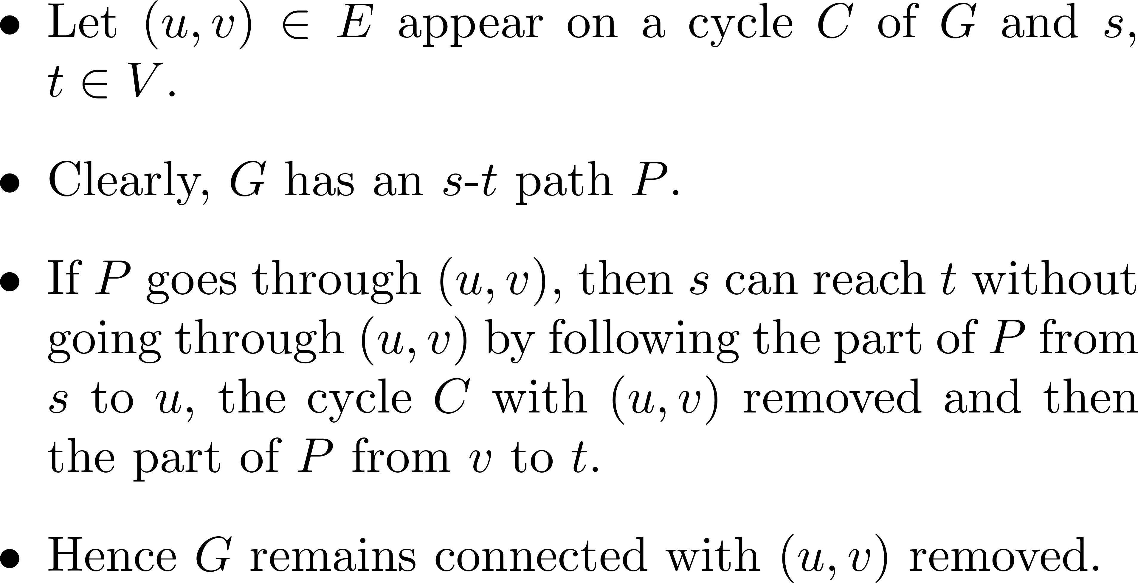
A written proof

Slide 6
Proved!

Slide 7
Theorem

Slide 8
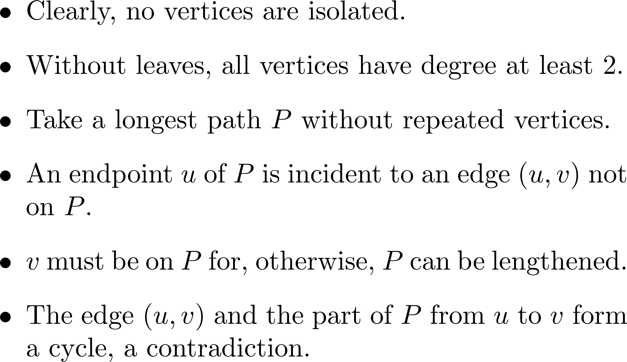
Proof

Slide 9

Illustration
…
u

Slide 10
Number of edges of trees

Slide 11
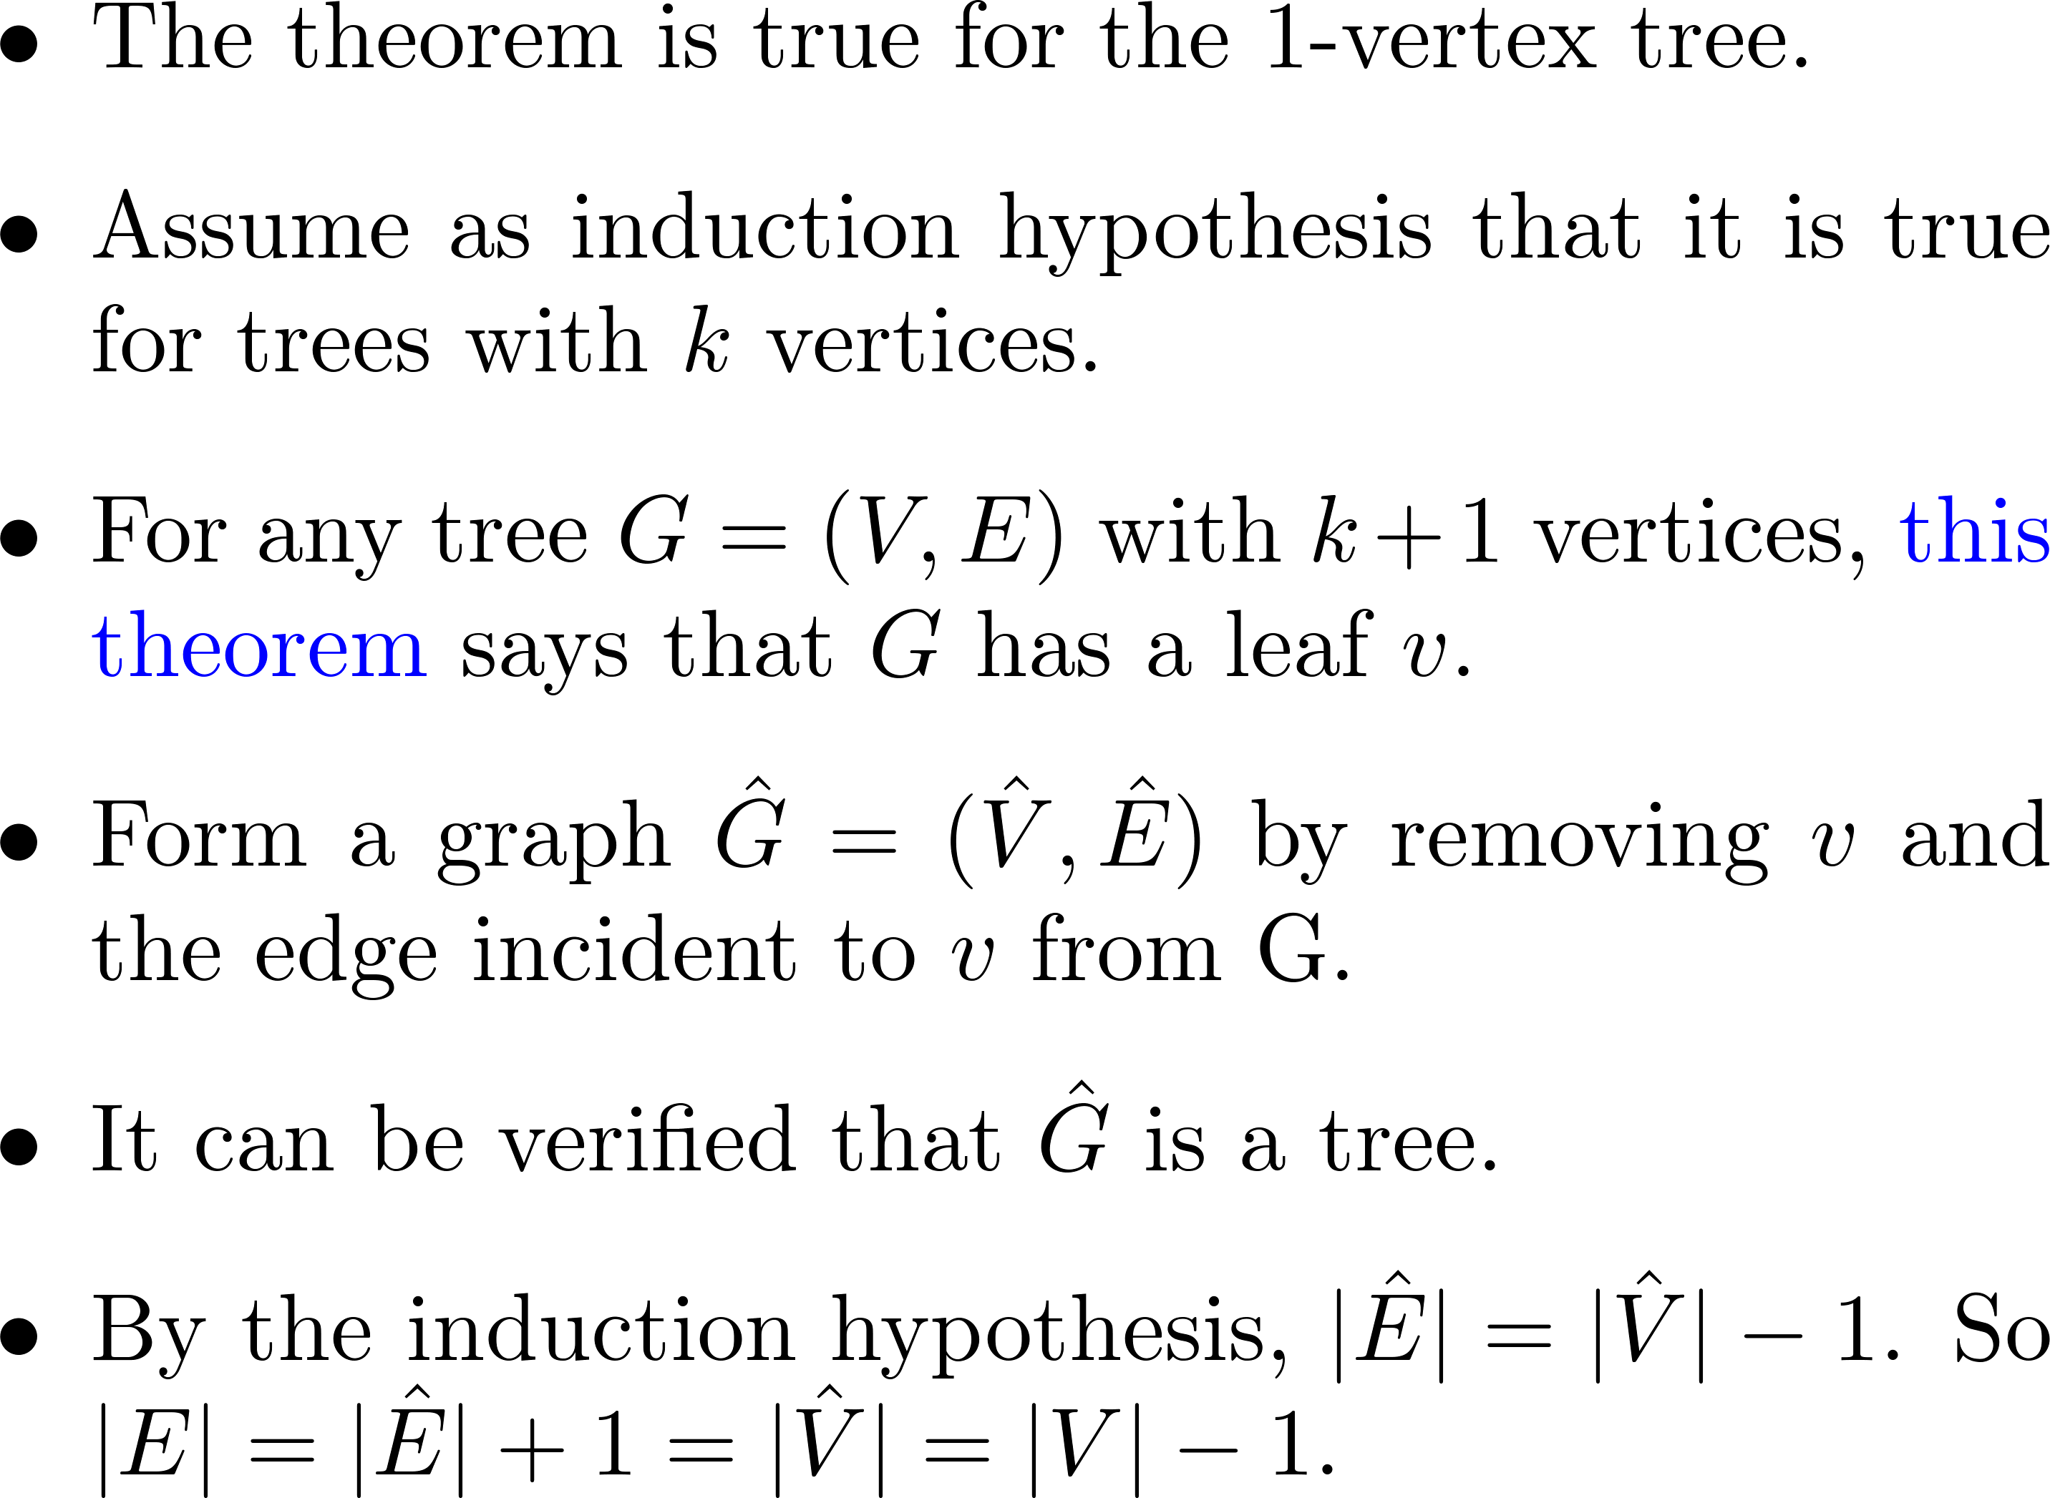
Proof ☺
___
______

Slide 12
Proved!

Slide 13
The converse

Slide 14
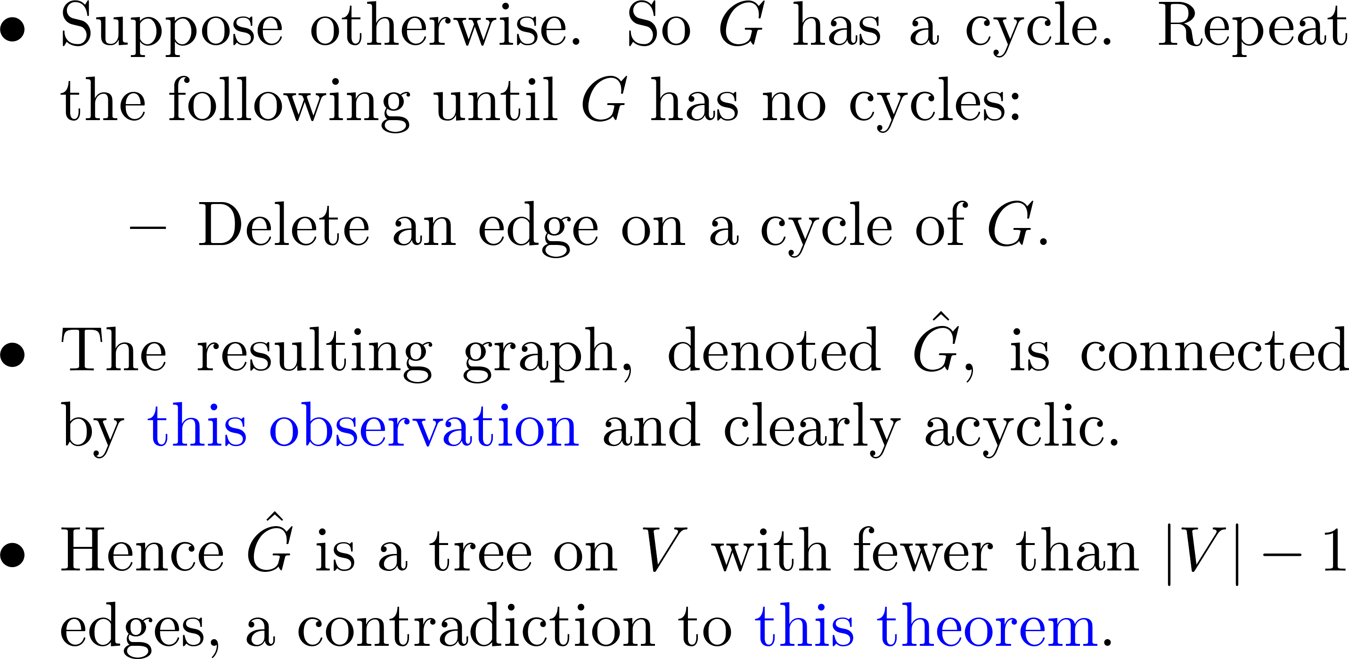
Proof
____________
__________

Slide 15
A property
Adding a new edge to a tree creates a unique cycle, removing any one edge from which results in a tree.

Slide 16
Illustration
v

Slide 17
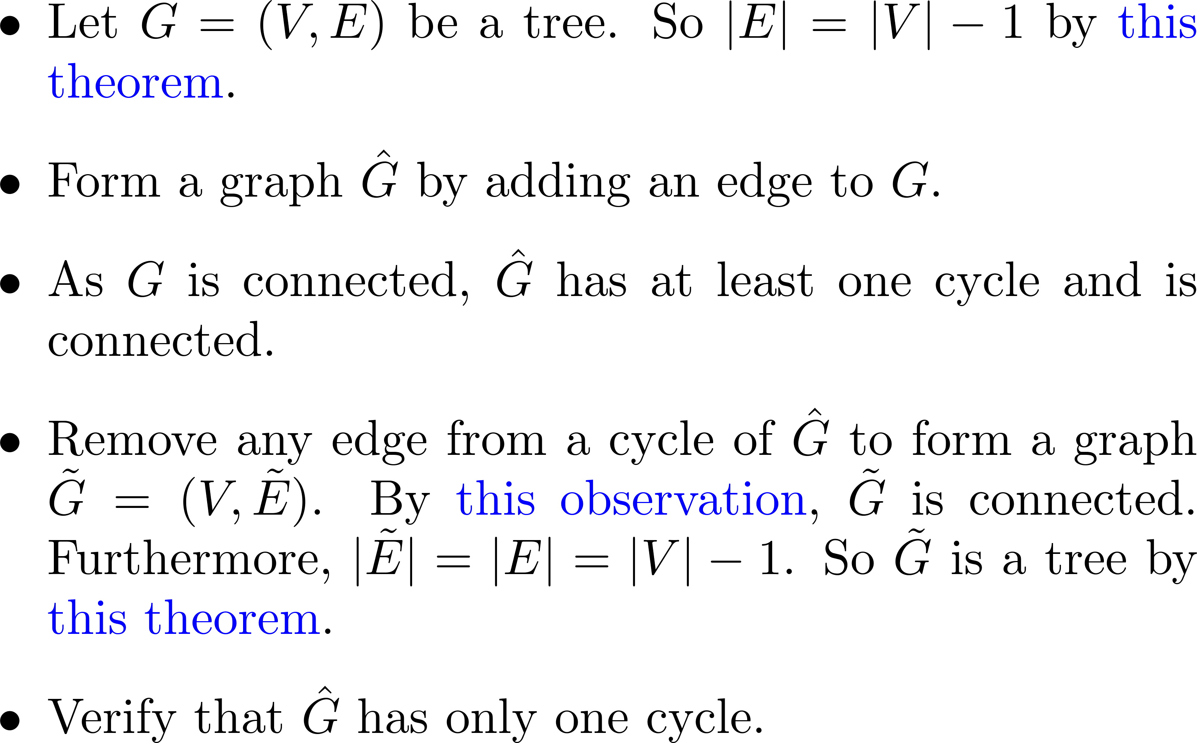
Proof ☺
_____
__________
___________________
_______________

Slide 18
Comments?

